Slide 1

Punctuality Drive
Group Members
Sadiq Ali
Rahul Yadav
Shivam Shukla
Suryansh Shukla
Tushar Sharma
Under Guidance Of
mrs-Indu Verma

Slide 2
Introduction and Scope
This is punctuality drive where we decide which student is punctual or not, by marking their attendance at the time of entering in college and prepare a report of all punctual and late comers.
This application helps college to track student’s record
Face detection is a computer vision technology that helps to locate/visualize human faces in digital images. This technique is a speciﬁc use case of object detection technology that deals with detecting instances of semantic objects of a certain class (such as humans, buildings or cars) in digital images and videos. With the advent of technology, face detection has gained a lot of importance especially in ﬁelds like photography, security, and marketing.

Slide 3
Innovation Idea of Project
1.It can Detect faces easily with less time of execution.
2.It can Detect single, double or even multiple faces in Webcam.
3.It can tell the number of Peoples/faces in Image.
4.It is fully automatic face recognition system
5.It is one of the best in today world Innovation as per less number of code use in the system.
6.It use Haar feature based Algorithm to detect which it makes very accurate and fast processing of face detection

Slide 4
Purpose
The purpose of punctuality drive is to mark attendance of the student by face recognition and hence making a report of the defaulters (late comers) and those students who are punctual.
Main aim of this application is track the punctual students and try to make a noticeable shift in their habit, by giving them rewards and appreciations.

Slide 5
Open-CV Python
OpenCV essentially stands for Open Source Computer Vision Library. Although it is written in optimized C/C++, it has interfaces for Python and Java along with C++. OpenCV boasts of an active user base all over the world with its use increasing day by day due to the surge in computer vision applications.
OpenCV-Python is the python API for OpenCV. You can think of it as a python wrapper around the C++ implementation of OpenCV. OpenCV-Python is not only fast (since the background consists of code written in C/C++) but is also easy to code and deploy(due to the Python wrapper in foreground). This makes it a great choice to perform computationally intensive programs.

Slide 6
Installation
OpenCV-Python supports all the leading platforms like Mac OS, Linux, and Windows. It can be installed in either of the following ways:
Packages for standard desktop environments (Windows, macOS, almost any GNU/Linux distribution)
●run pip install opencv-python if you need only main modules
●run pip install opencv-contrib-python if you need both main and contrib modules

Slide 7
Language used
Front end
Python Tkinter GUI
Python offers multiple options for developing GUI (Graphical User Interface). Out of all the GUI methods, tkinter is the most commonly used method. It is a standard Python interface to the Tk GUI toolkit shipped with Python. Python with tkinter is the fastest and easiest way to create the GUI applications. Creating a GUI using tkinter is an easy task.
To create a tkinter app:
Importing the module – tkinter
Create the main window (container)
Add any number of widgets to the main window
Apply the event Trigger on the widgets.

Slide 8
Back end
My Sql
MySQL is an open-source relational database management system.
MySQL is a relational database management system based on the Structured Query Language, which is the popular language for accessing and managing the records in the database. MySQL is open-source and free software under the GNU license. It is supported by Oracle Company.
CSV File
A CSV is a comma-separated values file, which allows data to be saved in a tabular format. CSVs look like a garden-variety spreadsheet but with a . csv extension.

Slide 9
Team members and their roles
Sadiq Ali :- Front end,Face Recognize module ,mark attendance and train data
Shivam Shukla :- Testing ,Documentation
Suryansh Shukla :-Front End and Backend Support
Rahul yadav:- Back end
Tushar Sharma :- Information Gathering

Slide 10
Project Modules
Student Detail
Insert student data consisting of [ Student ID, Name, Email ID, Branch, Year, Semester, Father’s Name, DOB, Gender, etc… ]
Data Capture
In data capture we capture student’s face and save with their respective details
Data Training
In data training we train data on the basis of given images details.
Face Recognition
In Face Recognition we recognize student’s face.
Mark Attendance
In this attendance is marked on the basis of recognized face.
Report Generation
In this we generate a report on the basis of student’s performance or punctuality.

Slide 11
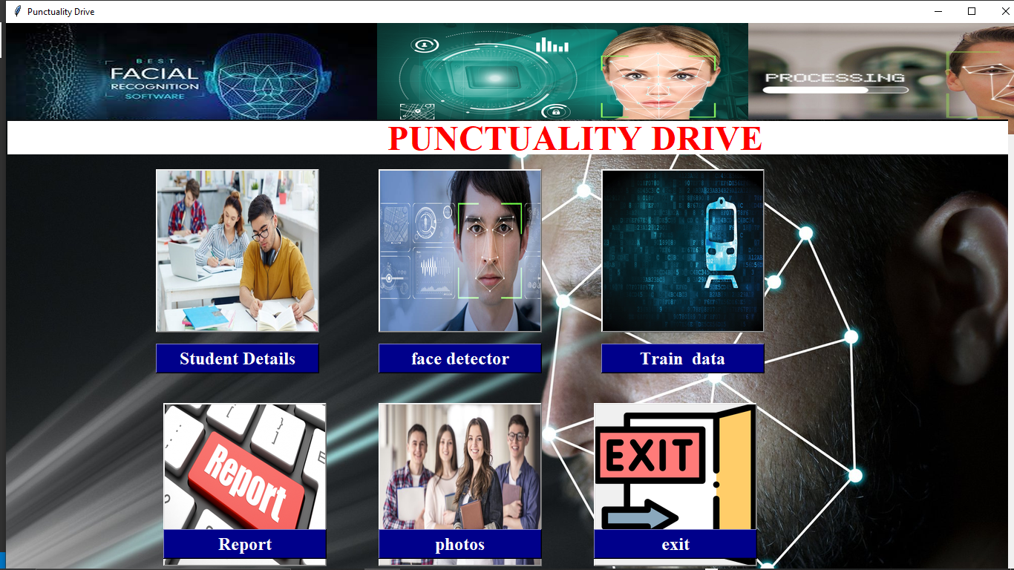
Snapshots Of Running Project
Home Page

Slide 12
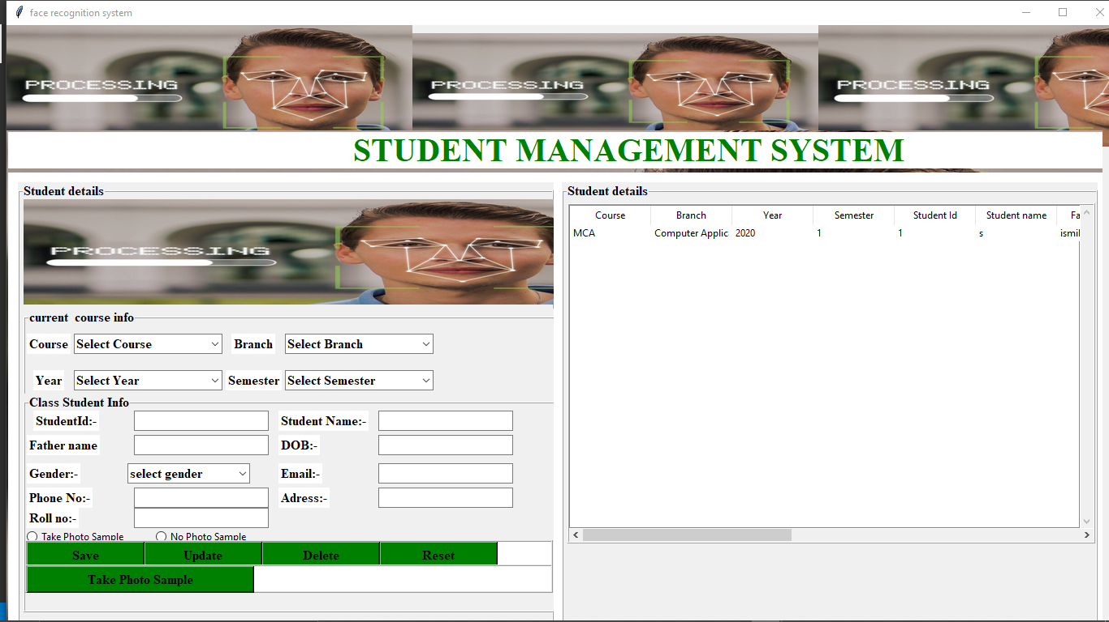
Student Details

Slide 13
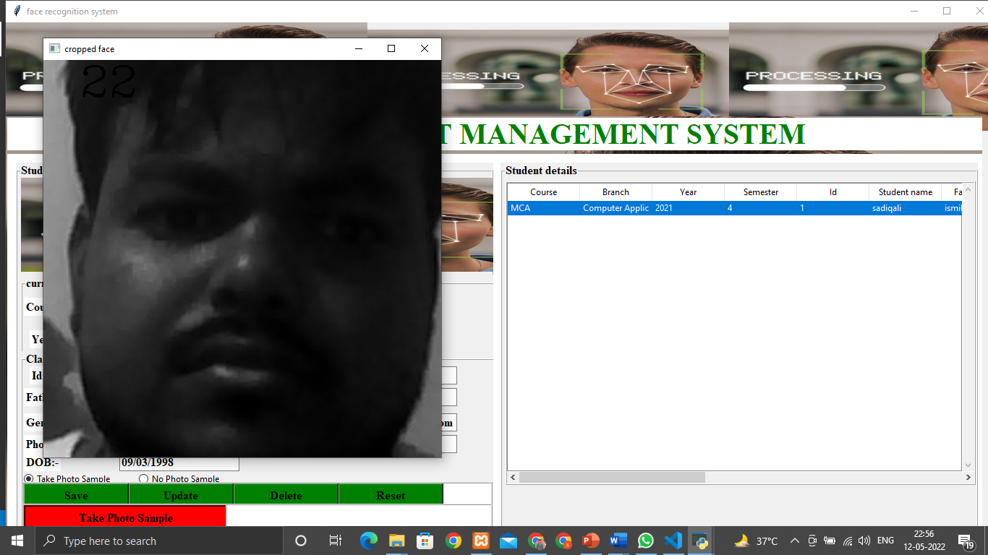
Take Photo Sample

Slide 14
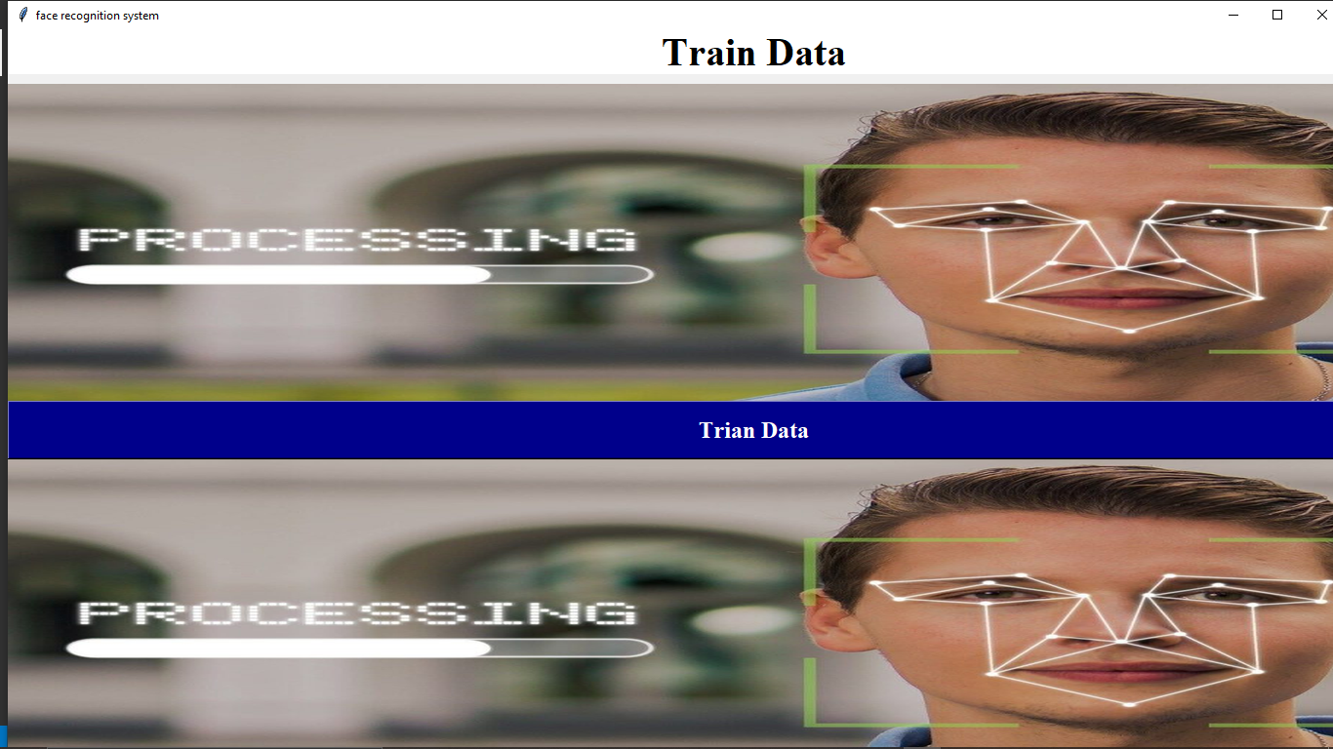
Training Data

Slide 15
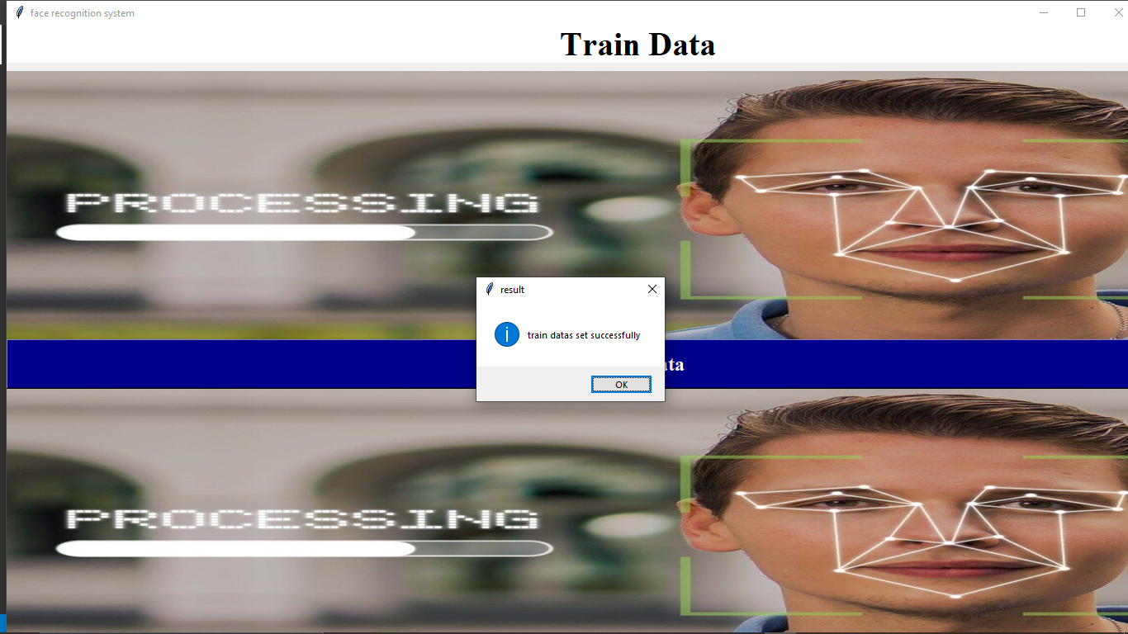
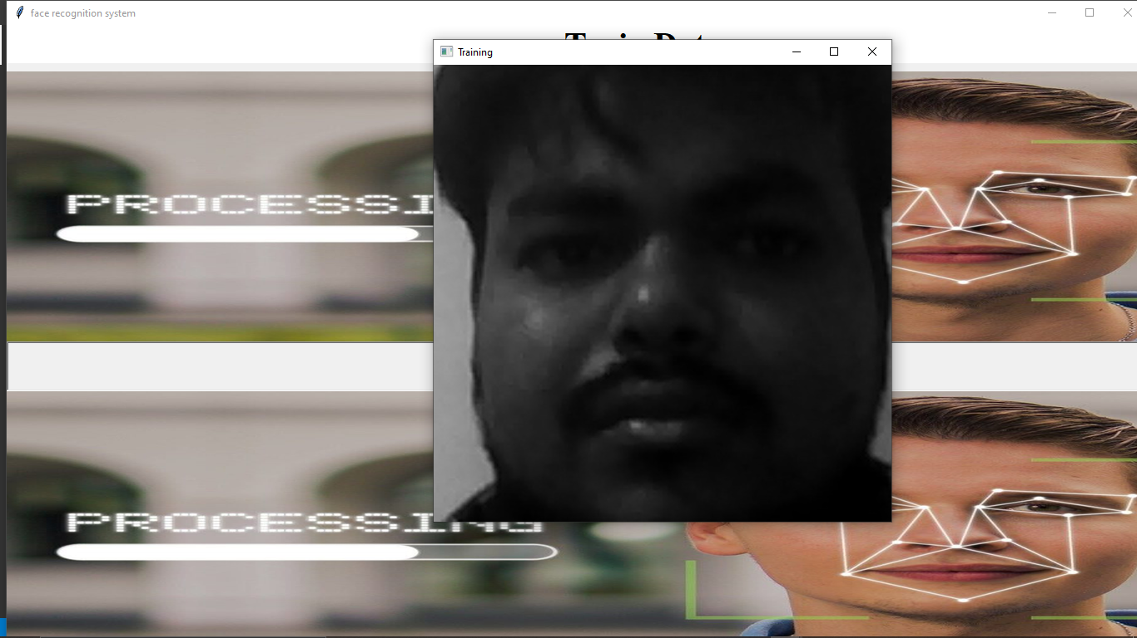
Training Data Set

Slide 16
Face Detection
Face detection is a technique that identifies or locates human faces in digital images. A typical example of face detection occurs when we take photographs through our smartphones, and it instantly detects faces in the picture.
Face detection is different from Face recognition. Face detection detects merely the presence of faces in an image while facial recognition involves identifying whose face it is. In this article, we shall only be dealing with the former.
Face recognition is the task of identifying an already detected object as a known or unknown face. Often the problem of face recognition is confused with the problem of face detection Face Recognition on the other hand is to decide if the "face" is someone known, or unknown, using for this purpose a database of faces in order to validate this input face.

Slide 17
Face Detection Classifier
Face detection is performed by using classifiers. A classifier is essentially an algorithm that decides whether a given image is positive(face) or negative(not a face). A classifier needs to be trained on thousands of images with and without faces. Fortunately, OpenCV already has two pre-trained face detection classifiers, which can readily be used in a program. The two classifiers are:
● Haar Classifier and
● Local Binary Pattern Histogram(LBPH)

Slide 18
Haar features
Rectangular Haar-like feature are often defined because the difference of the sum of pixels of areas inside the rectangle, which may be at any position and scale within the first image. This modified feature set is named 2-rectangle feature. Viola and Jones also defined 3-rectangle features and 4-rectangle features.
The values indicate certain characteristics of a specific area of the image. Each feature type can indicate the existence (or absence) of certain characteristics within the image, like edges or changes in texture. for instance, a 2-rectangle feature can indicate where the border lies between a dark region and a light-weight region.

Slide 19
Haar Feature Cascade Classifier Haar Cascade is an algorithm-based learning algorithm used to identify objects in a picture or video and is based on the concept of objects suggested by Paul Viola and Michael Jones in their paper "Accelerated Acquisition using the Expanded Cascade of Simple Features" in 2001. It is a machine learning technique where Cascade's work is trained from many positive and negative images. After that it is used to find objects in other images. It is known for the ability to see faces and body parts through a photograph, but it can be trained to detect almost anything.

Slide 20
Haar Feature Cascade Classifier
Step1: -Enter the XML file for the haar feature classifier.
Step2: -Enter the input as pictures.
Step3: - Convert RGB image to GRAY image.
Step4: - Look Face.
Step5: - Draw a rectangle/traingle around the face.
Step6: -Show the result

Slide 21
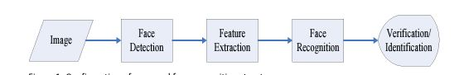
Face Recognition
we focus on image-based face recognition. Given a picture taken from a digital camera, we’d like to know if there is any person inside, where his/her face locates at, and who he/she is. Towards this goal, we generally separate the face recognition procedure into three steps: Face Detection, Feature Extraction, and Face Recognition (shown at Fig. 1). Image Face Detection Feature Extraction Figure 1: Configuration of a general face recognition structure Face Detection: Face Recognition Verification

Slide 22
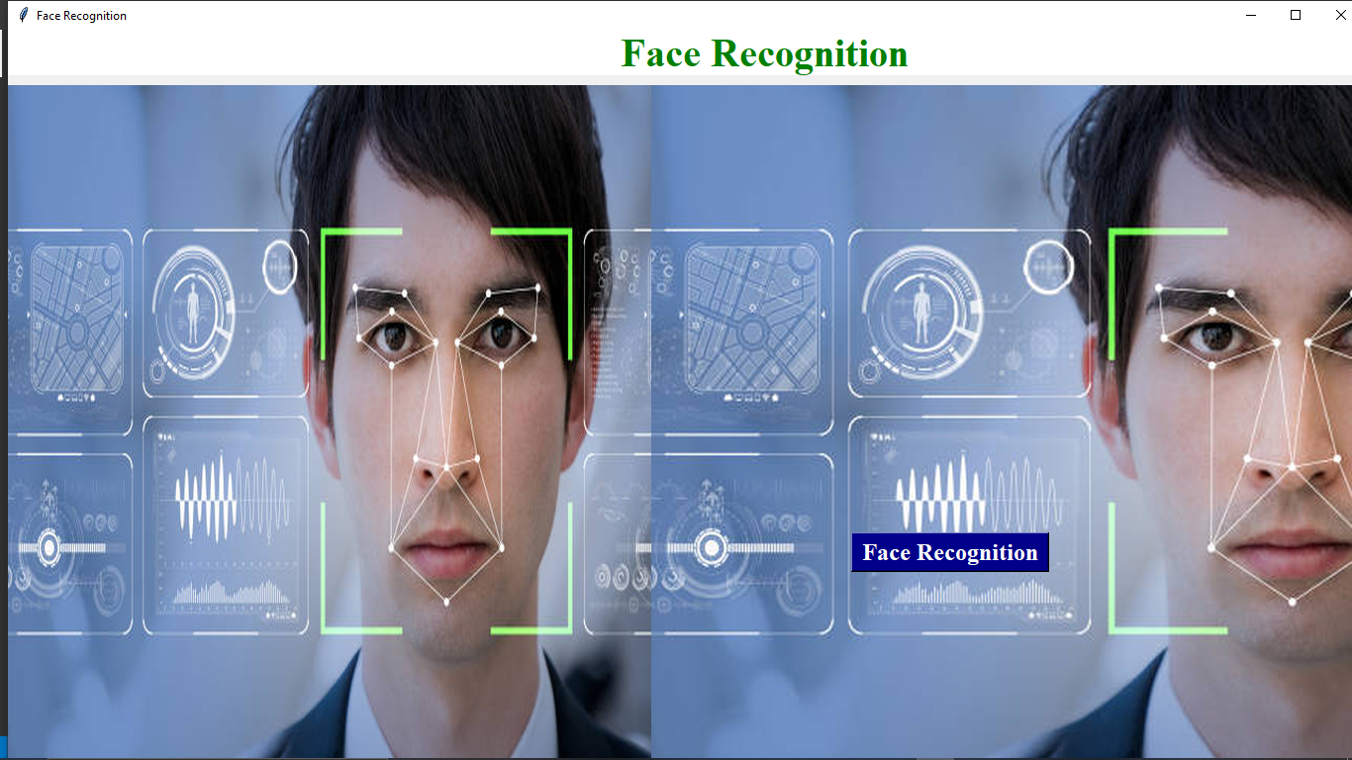
Face Recognition

Slide 23
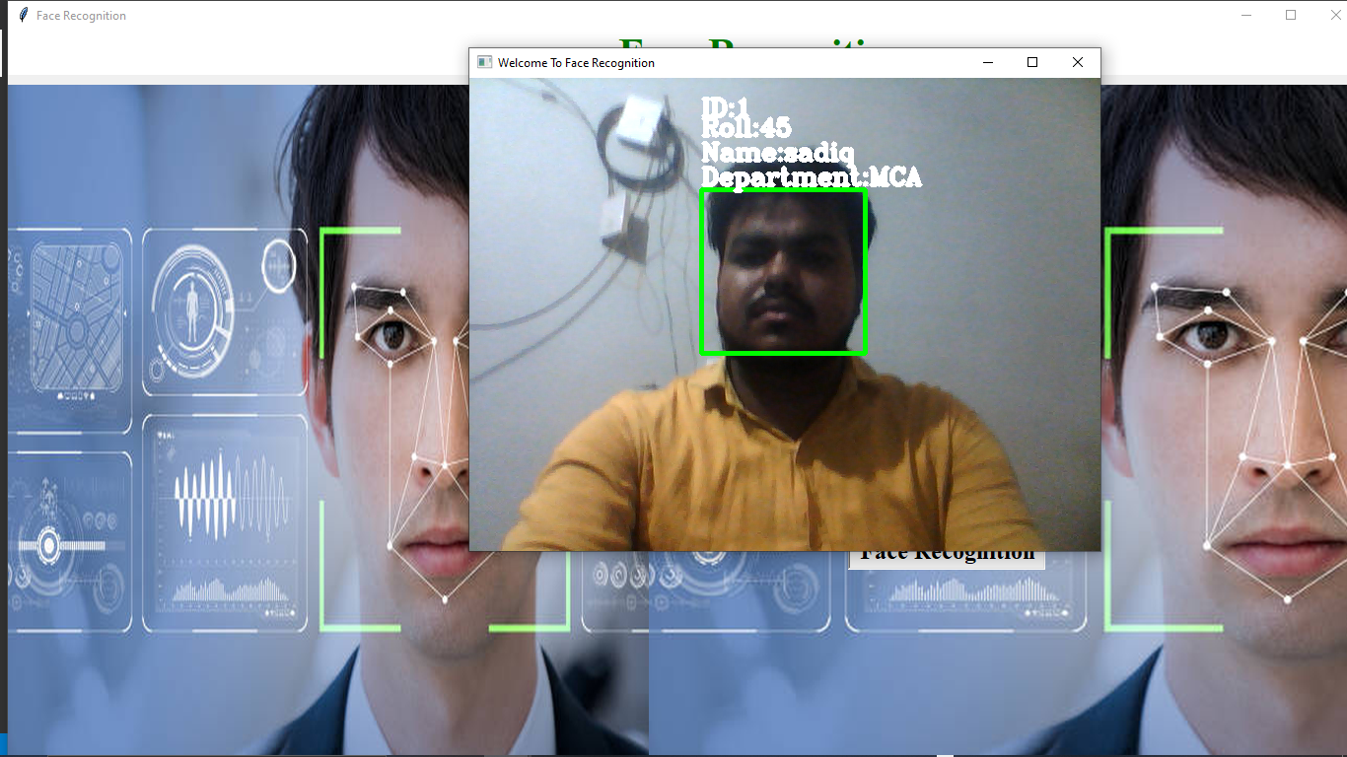
Face Recognize

Slide 24
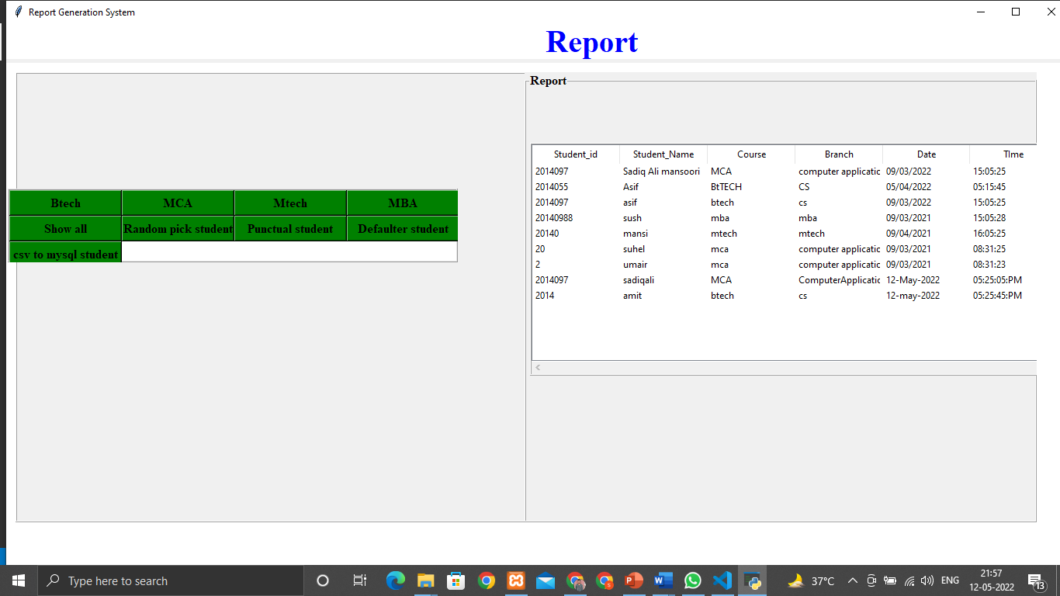
Report Generation

Slide 25
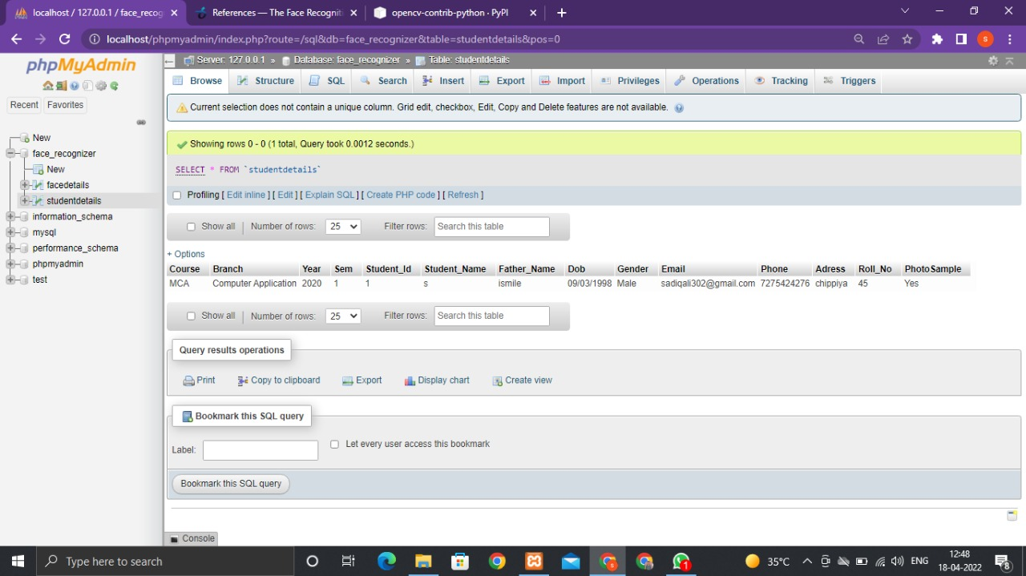
Database Student Details

Slide 26
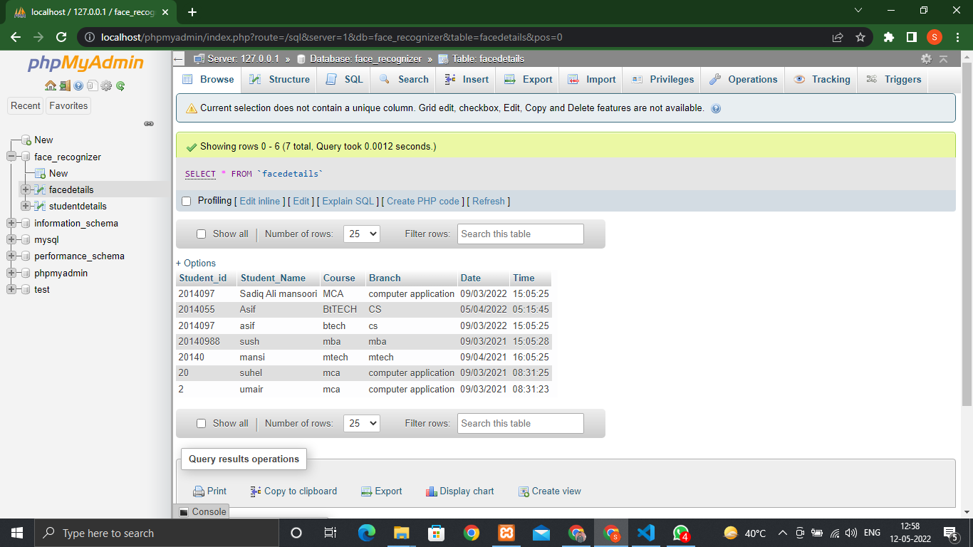
Database Attendance facedetails

Slide 27
Thank You

